Slide 1
Module 03
Software Estimation & Scheduling

Slide 2
Example of LOC-Based Estimation
As an example of LOC and FP problem-based estimation techniques, let us consider a software package to be developed for a computer-aided design application for mechanical components. A review of the System Specification indicates that the software is to execute on an engineering workstation and must interface with various computer graphics peripherals including a mouse, digitizer, high resolution color display and laser printer.

Slide 3
Using the System Specification as a guide, a preliminary statement of software scope can be developed:
The CAD software will accept two- and three-dimensional geometric data from an engineer. The engineer will interact and control the CAD system through a user interface that will exhibit characteristics of good human/machine interface design. All geometric data and other supporting information will be maintained in a CAD database. Design analysis modules will be developed to produce the required output, which will be displayed on a variety of graphics devices. The software will be designed to control and interact with peripheral devices that include a mouse, digitizer, laser printer, and plotter.

Slide 4
This statement of scope is preliminary—it is not bounded. Every sentence would have to be expanded to provide concrete detail and quantitative bounding. For example, before estimation can begin the planner must determine what "characteristics of good human/machine interface design" means or what the size and sophistication of the "CAD database" are to be.

Slide 5
For our purposes, we assume that further refinement has occurred and that the following major software functions are identified:
• User interface and control facilities (UICF)
• Two-dimensional geometric analysis (2DGA)
• Three-dimensional geometric analysis (3DGA)
• Database management (DBM)
• Computer graphics display facilities (CGDF)
• Peripheral control function (PCF)
• Design analysis modules (DAM)

Slide 6
Following the decomposition technique for LOC, an estimation table, shown in Figure 5.2, is developed.
A range of LOC estimates is developed for each function. For example, the range of LOC estimates for the 3D geometric analysis function is:
Optimistic= 4600 LOC. (Best Case)
Most likely=6900 LOC. (Average Case)
Pessimistic=8600 LOC. (Worst Case)
The estimated LOC = (Sopt + 4*Sm + Spess) / 6
= (4600+4*6900+8600)/ 6
=6800 LOC
Applying Equation (5-1), the expected value for the 3D geometric analysis function is 6800 LOC. Other estimates are derived in a similar fashion.

Slide 7
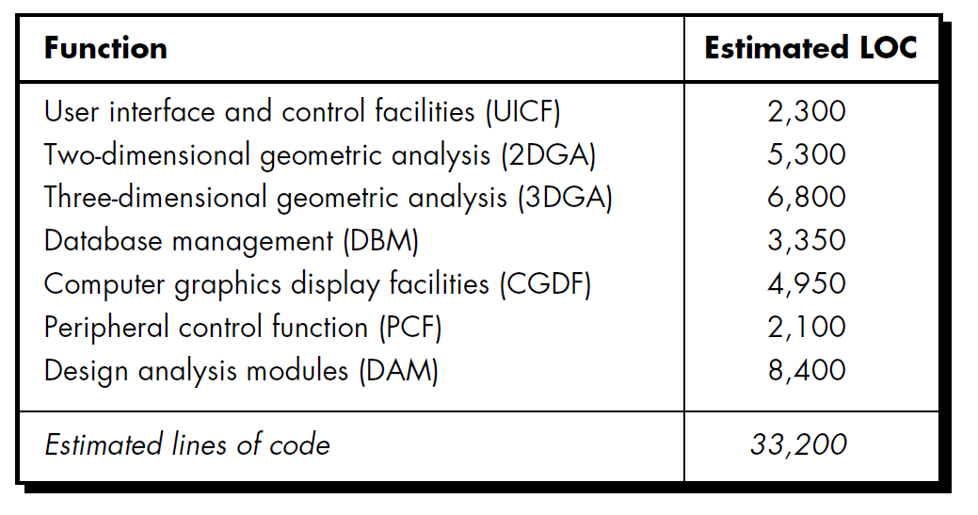

Slide 8
By summing vertically in the estimated LOC column, an estimate of 33,200 lines of code is established for the CAD system. A review of historical data indicates that:
The organizational average productivity for systems of this type is 620 LOC/pm.
Based on a burdened labor rate of $8000 per month.
Calculate
Cost per line of code
Total estimated project cost
Estimated effort

Slide 9
Therefore
The cost per line of code?
Labour rate per month/average productivity---8000/620=13
cost per line of code is $13
is approximately $13. (8000$ pm/620 LOC/ pm)
Based on the LOC estimate and the historical productivity data:
The total estimated project cost? Total estimated LOC* Cost per LOC
33,200*13= $431,000.
is $431,000. (13$ * 33200)
The estimated effort ? Total estimated LOC/average productivity
33200/620=54
is 54 person-months. (33200/620)

Slide 10
5-6-2 an Example of FP-Based Estimation
Decomposition for FP-based estimation focuses on information domain values rather than software functions. Referring to the function point calculation table presented in Figure 5.3, the project planner estimates inputs, outputs, inquiries, files, and external interfaces for the CAD software. For the purposes of this estimate, the complexity weighting factor is assumed to be average. Figure 5.3 presents the results of this estimate.

Slide 11
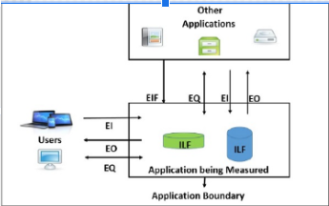

Slide 12
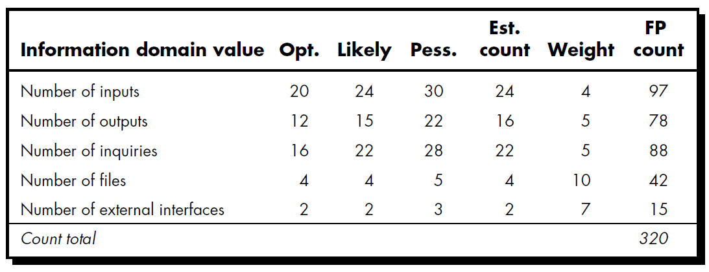
(Sopt + 4*Sm + Spess) / 6
(20+4*24+30)/6=24
FP count= Est count * Weight

Slide 13
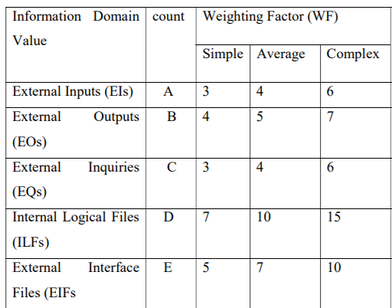

Slide 14
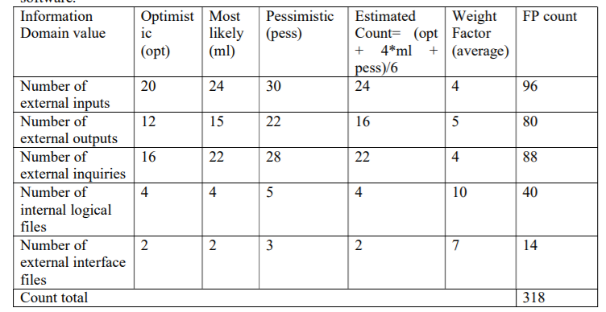

Slide 15
Each of the complexity weighting factors is estimated and the complexity adjustment factor is computed as described in Chapter 4:
Factor Value
Backup and recovery 4
Data communications 2
Distributed processing 0
Performance critical 4
Existing operating environment 3

Slide 16
On-line data entry 4
Input transaction over multiple screens 5
Master files updated on-line 3
Information domain values complex 5
Internal processing complex 5
Code designed for reuse 4
Conversion/installation in design 3
Multiple installations 5
Application designed for change 5
Total 52
[0.65 + 0.01 X ∑(Fi)] = 0.65+0.01*52=1.17
Complexity adjustment factor 1.17

Slide 17
Finally, the estimated number of FP is derived:
FP estimated = count-total X [0.65 + 0.01 X ∑(Fi)]
=318*1.17=372
The organizational average productivity for systems of this type is 6.5 FP/pm. Based on a burdened labor rate of $8000 per month;
Calculate
Cost per FP
Total estimated project cost
Estimated effort

Slide 18
the cost per FP ? Labour rate/average productivity
8000/6.5=1230is approximately $1230.
Based on the LOC estimate and the historical productivity data, the total estimated project cost ?
372 *1230= $ 457560 is $461,000 and the estimated effort ? Total estimated fp/ productivity= 372/6.5= is 58 person-months.

